Slide 1

MUSIC AT ABINGDON

Slide 2



General Music
Ms. Kingsley and Dr. Heim

Slide 3
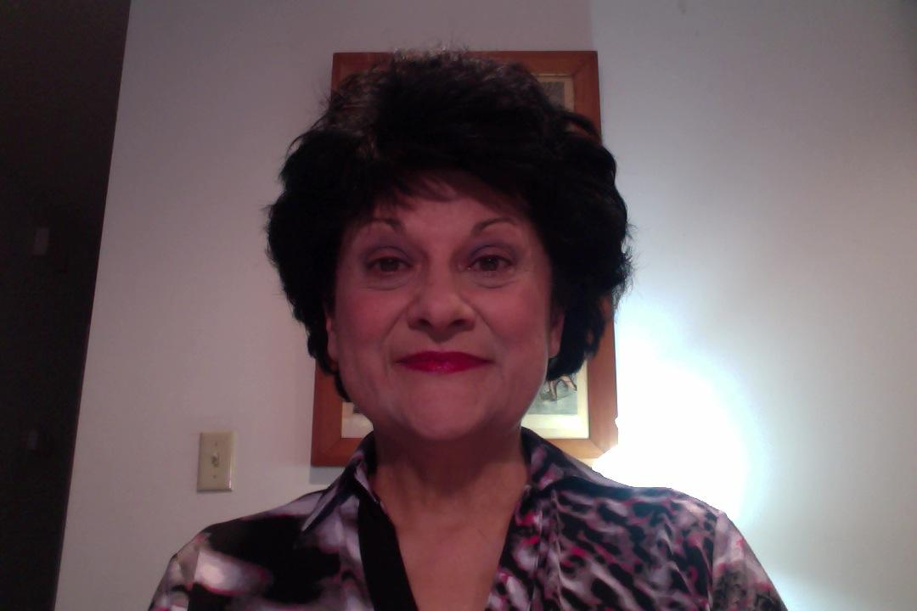
Ms. Kingsley
Education: BA in Music Education/Voice, Masters in Arts Administration
Certification and Training: Levels 1-3 Orff Schulwerk; semester of Kodaly training; Graduate Certification in Theatre,CUA; acting and dance training in NYC studios
Performance: Regional, Stock, Off-Broadway theatres, choral, recital
Production/Directing: theatre education wing for Off-Broadway theatre, NYC; non-profit theatre company in Oregon featuring history-enlightening productions; Arts-at Performing-Arts-Through-History youth programs and Community Arts & Meals; author/director of many youth plays based on history incorporating authentic literature, music and dance performed in schools and community centers.

Slide 4
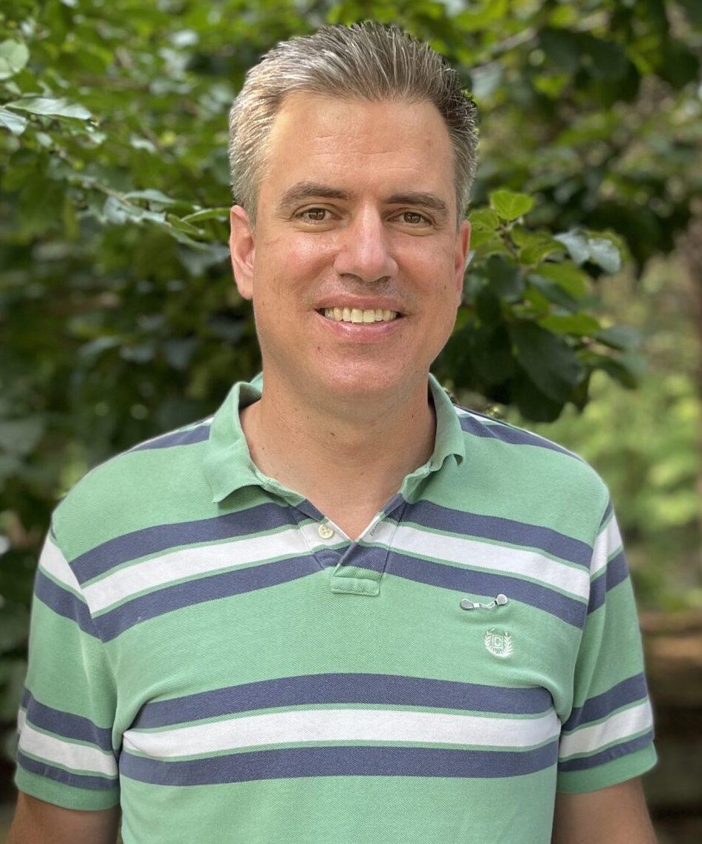
Dr. Heim
Doctor of Musical Arts (DMA), University of Maryland-College Park (Vocal Performance/Opera Studio); other degrees in conducting, voice and church music
Performed with several regional opera companies in the area (WNO, Baltimore Opera, Wolf Trap Opera, & smaller companies)
Year 16 teaching in Arlington
Orff Level 1 Certification; additional resources from First Steps in Music/Conversational Solfege (John Feierabend) and GamePlan (Kreske/DeLilles) used in classroom teaching

Slide 5
Processes: imitation, exploration, improvisation, literacy
mEDiUMS: speaking voice, singing voice, body percussion, body, pitched and unpitched elemental instruments
Literacy Tools: solfege hand-signs; rhythmic syllables
ELEMENTAL compositional devices: drones, ostinatos, elemental expanded forms, simple chordal progressions

Slide 6
Integration and Differentiation

Slide 7
Sequential and Spiral learning PK - 5
ACTVITIES
Singing
Dancing
Rhythmic and Creative Movement
Drama Strategies
Speech Chants
Playing Instruments
Skills
Recognizing, performing and creating with a progression of the elements of music, dance and drama through multi-cultural materials.
Gaining historical perspective of the performing arts.

Slide 8
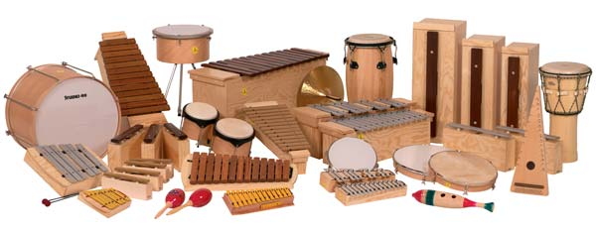
The Orff-Schulwerk ensemble

Slide 9


PRE-K (VPI)
Immersion in songs, rhymes/poems, dances, song stories
Instruments: mostly hand percussion to reinforce rhythm/steady beat
Developing a repertoire that can then be used as a reference point going forward (and spiraling back around) in higher grades

Slide 10
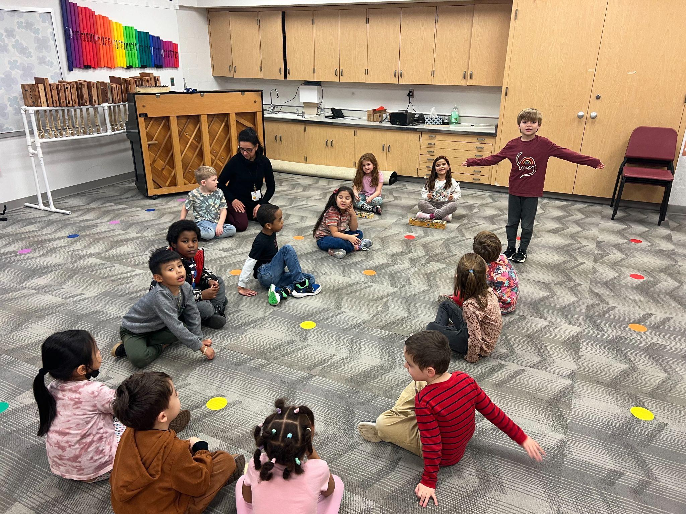
KINDERGARTEN
Continued development of repertoire of songs, rhymes/poems, movement, dances, and song stories which can be used in later grades to teach concepts
Mostly hand percussion instruments, but also some initial experiences with pitched percussion (glockenspiels, xylophones)
Some introduction to symbolic notation in preparation for music reading concepts (i.e. long/short, melodic contour shapes, syllabic/rhythmic connection)
Songs with Sol, Mi, La using hand signs, ear-training (echo/inner-hearing)
Improvisation/composition (movement and short rhythm patterns, “free” instrumental, sound scapes, improvisation with pentatonic scale; vocal improvisation)

Slide 11

SKATING TO Emile Waldteufel’s “Les Patineurs” (The Skaters)

Slide 12
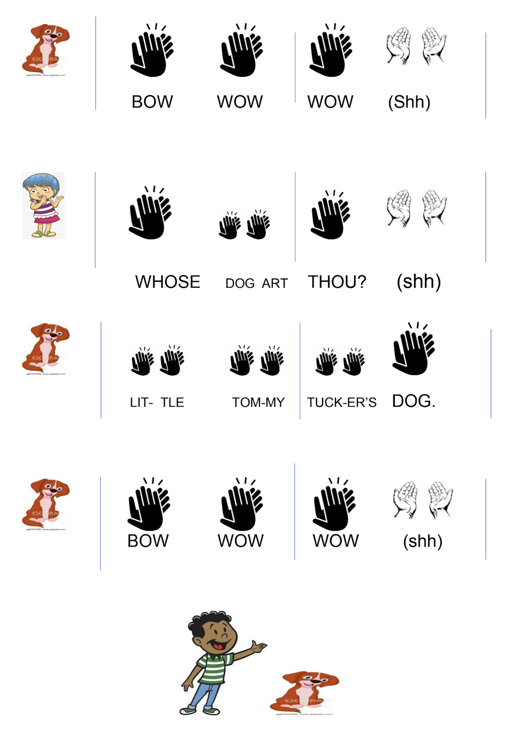
Example of symbolic rhythmic notation and rhyme as source of dramatization.

Slide 13
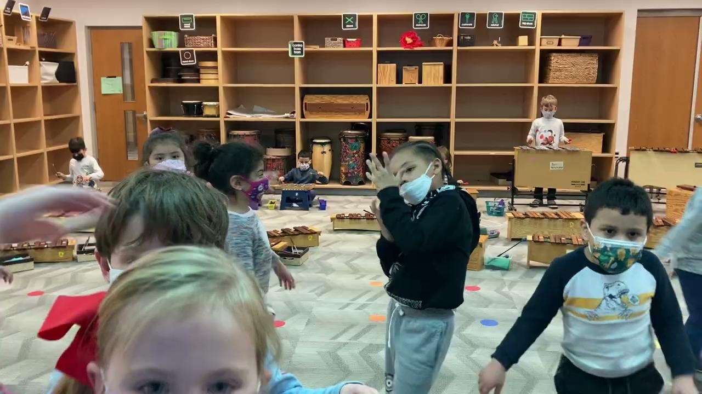
instrumental “free improvisation” with creative movement

Slide 14
1st Grade
Ms. Smith’s class: Hello Song
Continued development of repertoire of songs, rhymes/poems, movement, dances, and song stories which are used to teach concepts which are used in later grades to teach concepts
More use of pitched percussion instruments (xylophones, metallophones, glockenspiels) for both steady beat/accompaniment parts and beginning melodic parts and improvisation
Notation: transition from symbolic notation to quarter/eighth/half note notation and quarter rests; continued use of rhythm syllables for rhythmic patterns
Introduction to discreet pitch concepts
SOLFEGE: ‘sol-mi’ first, then adding ‘la’
High-low placement of ‘sol-mi-la’ on 3-line staff
Initial exposure to elements of music through contrasts (fast/slow—tempo, loud/quiet–dynamics, high-low–pitch, short/long–rhythm)
Initial exploration of form (AB repeated; ABA; phrase structures–aaba, abac, etc.)
Further improvisation of rhythm patterns, sung melodies, body percussion

Slide 15
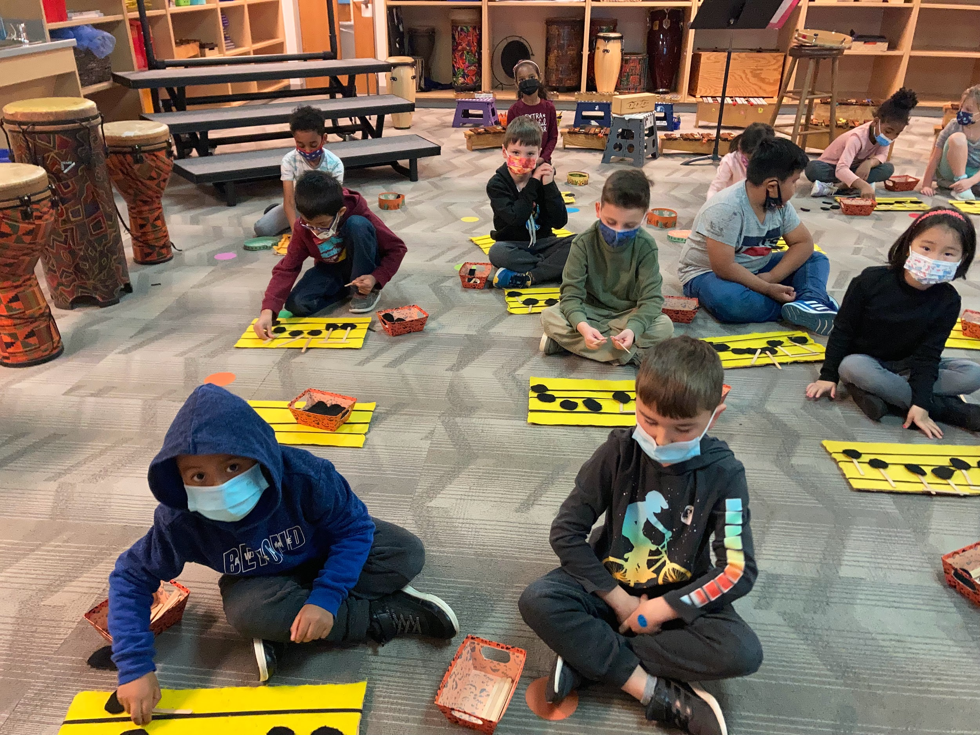
Notation: SOl, MI, La on 3-line staff

Slide 16
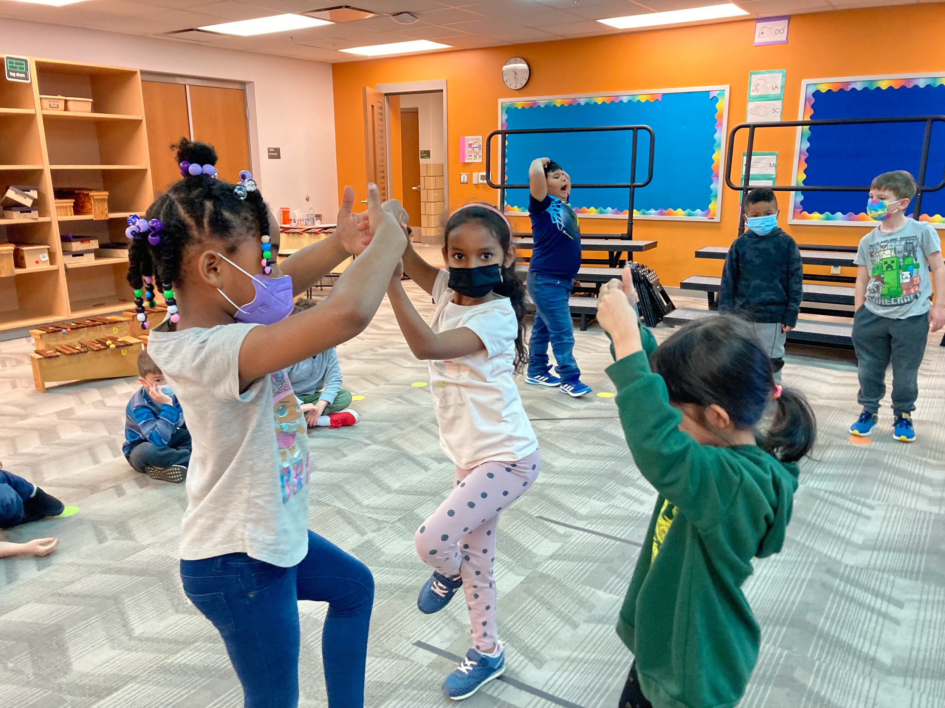
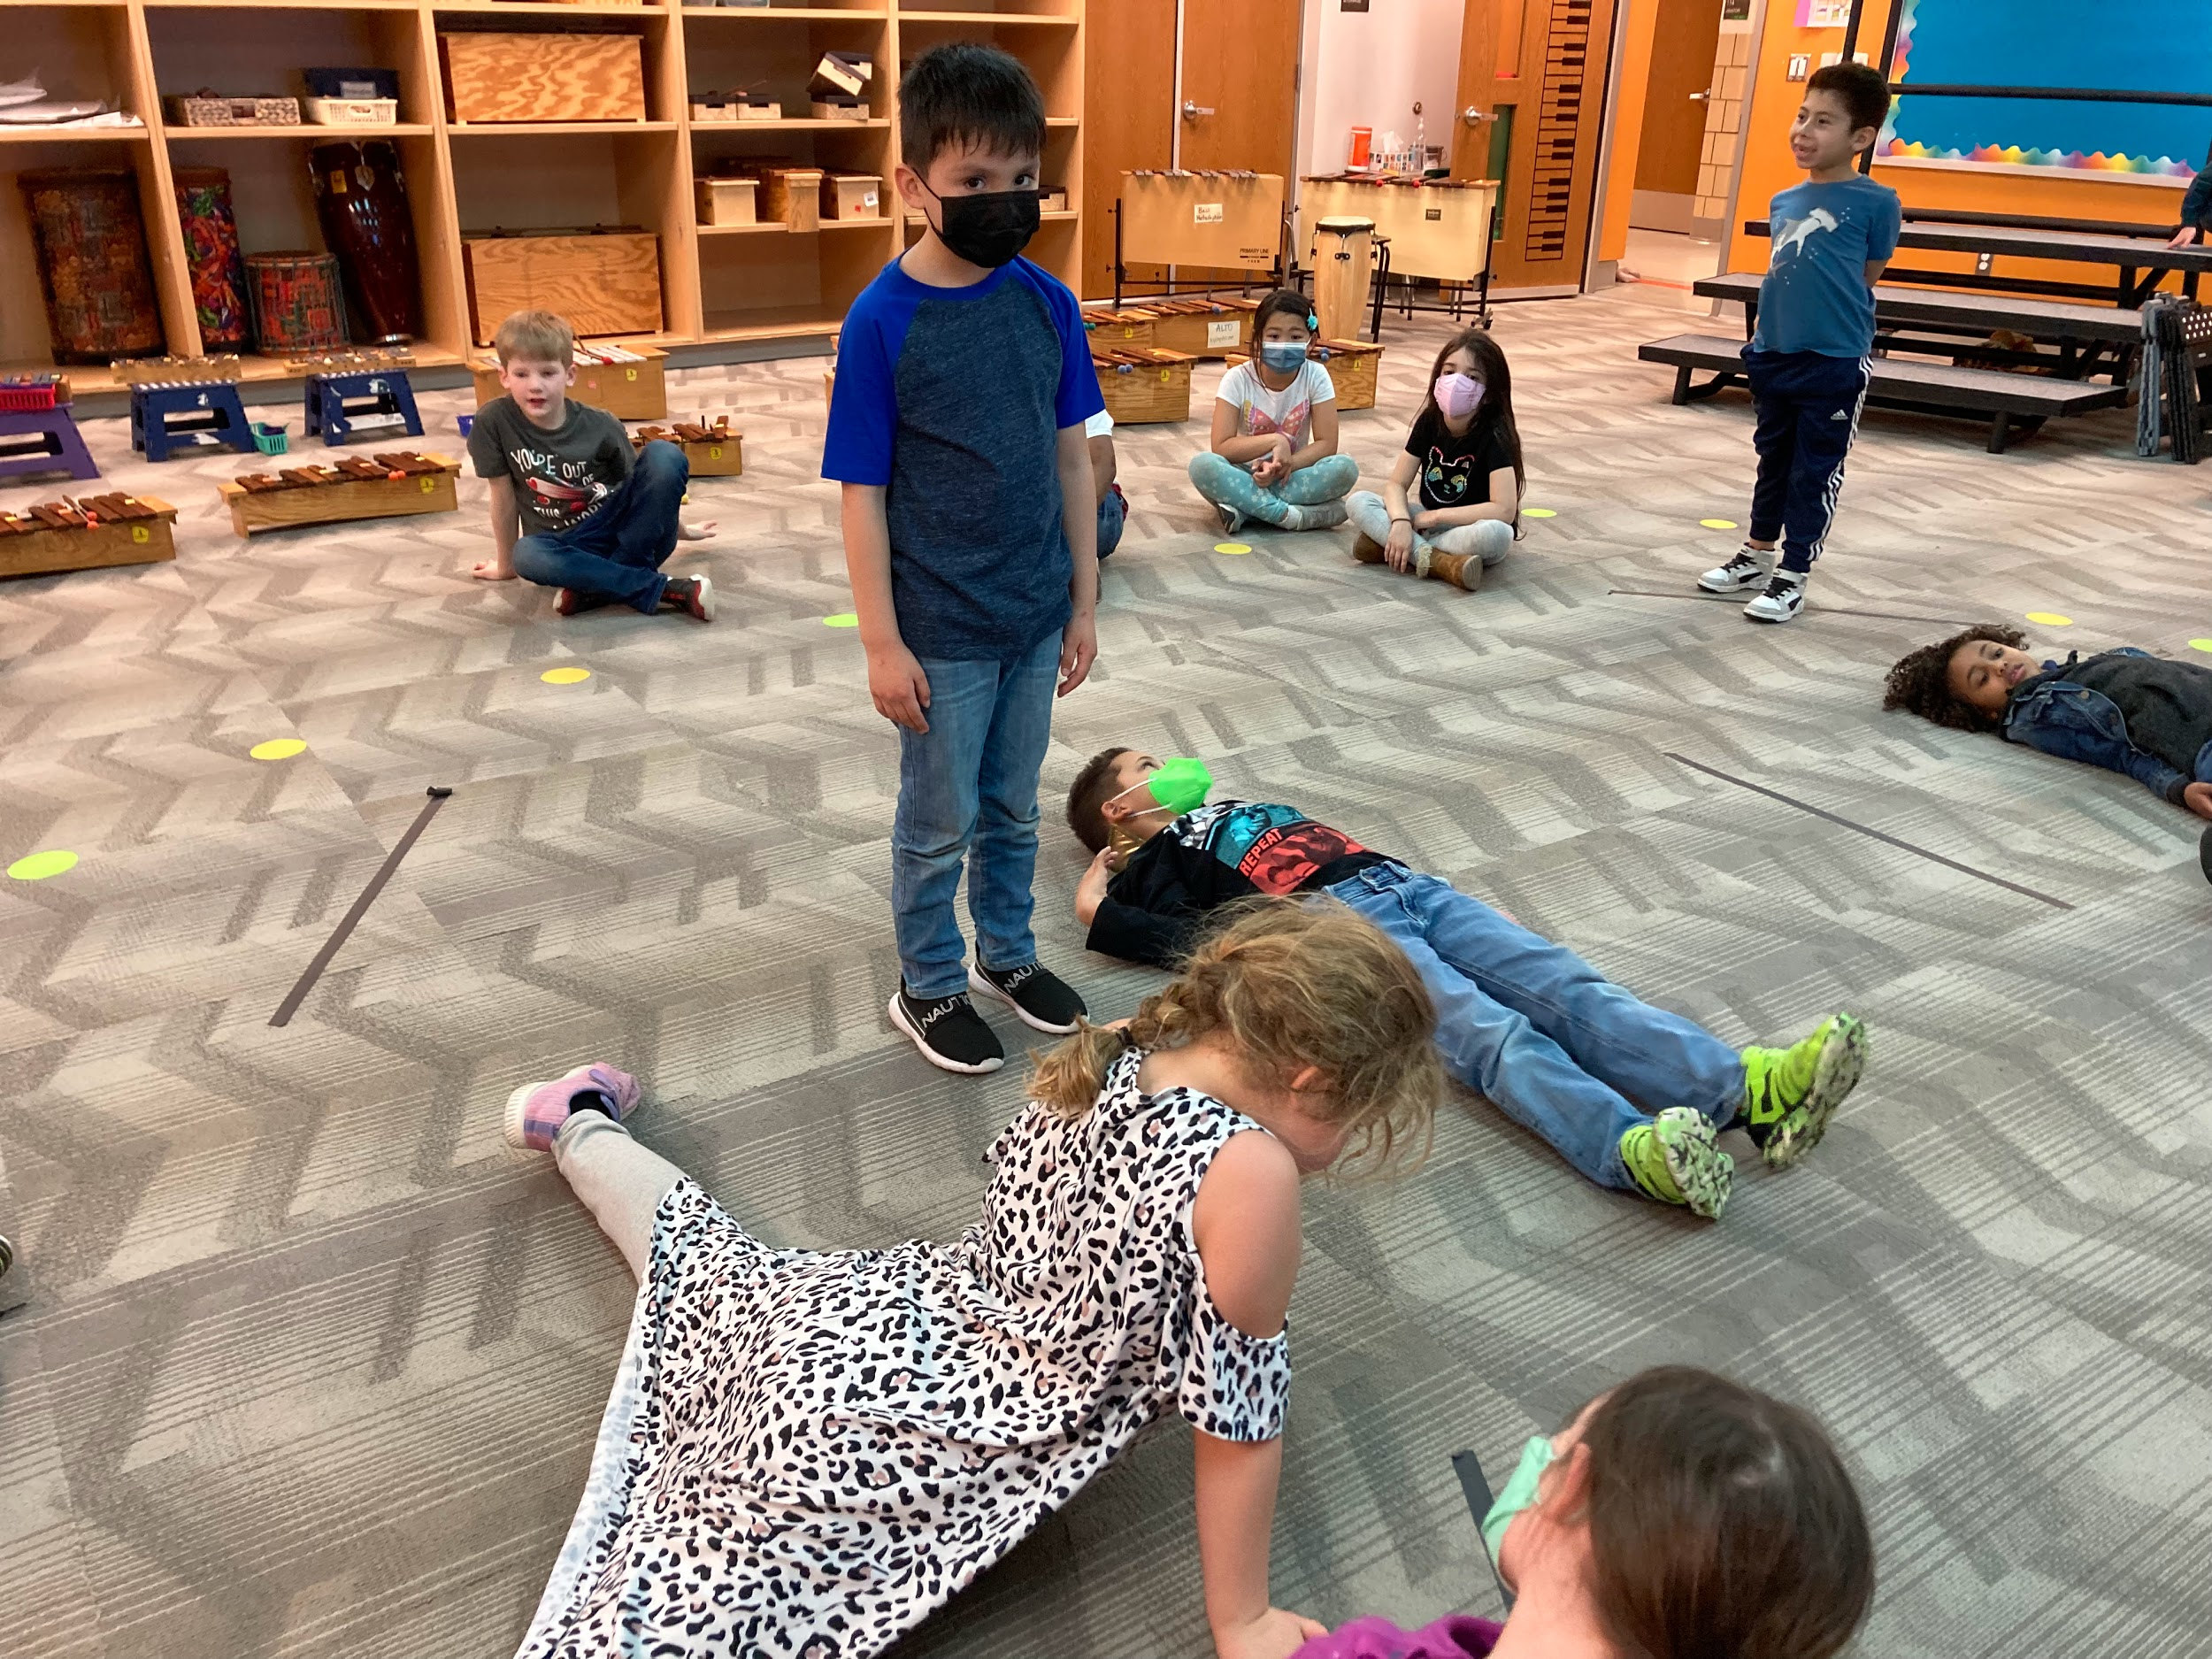
First Graders: Lines Trio and Angles Trio - a shape garden
(awareness of others - starting to be a MOVEMENT composition)
Extension:
We developed this into an ABA movement piece with the B section in zigzag, rounded or straight pathways.

Slide 17
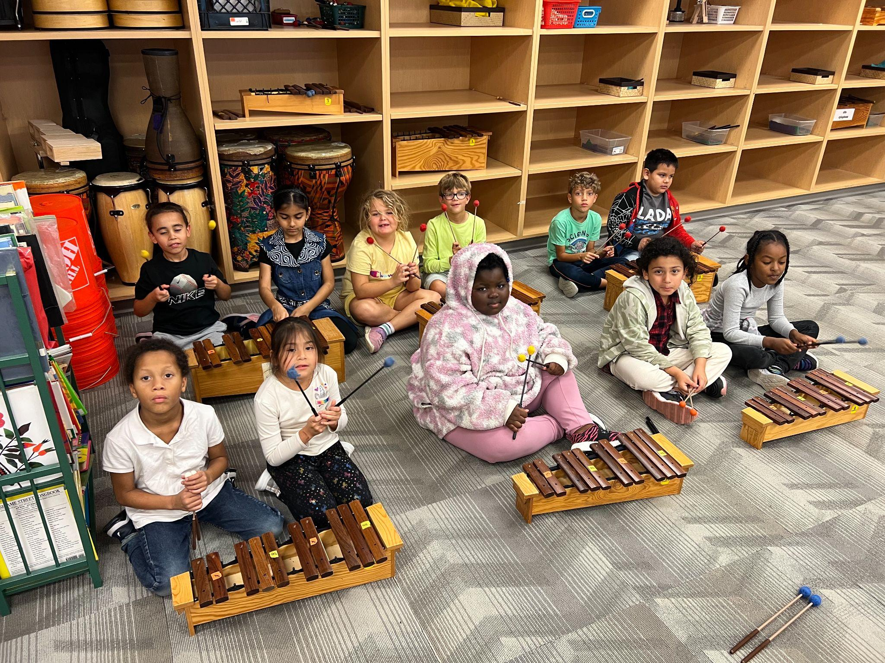
2nd Grade
Review of 1st Grade academic rhythm concepts (quarter, eighth,triplets, half notes, quarter rests) and pitch (sol-mi-la)
Continued new repertoire as well as review of former repertoire to introduce new concepts:
whole note, half and whole rests
beat patterns of 2, 3, and 4
adding mi-re-do to pitch vocabulary to make pentatonic scale
Introduction to triplet beat division (6/8 time)
More direct/overt exploration of elements of music (pitch, rhythm, dynamics, tempo, form) through critical listening and other activities/games/dances
Instrument families: Western classical and Multi-Cultural
Performing and creating more complex dances and occasionally accompanying them with instruments.
Narrated drama forms with music and movement.
Using pitched percussion instruments both as rhythmic and melodic concepts and skills.

Slide 18
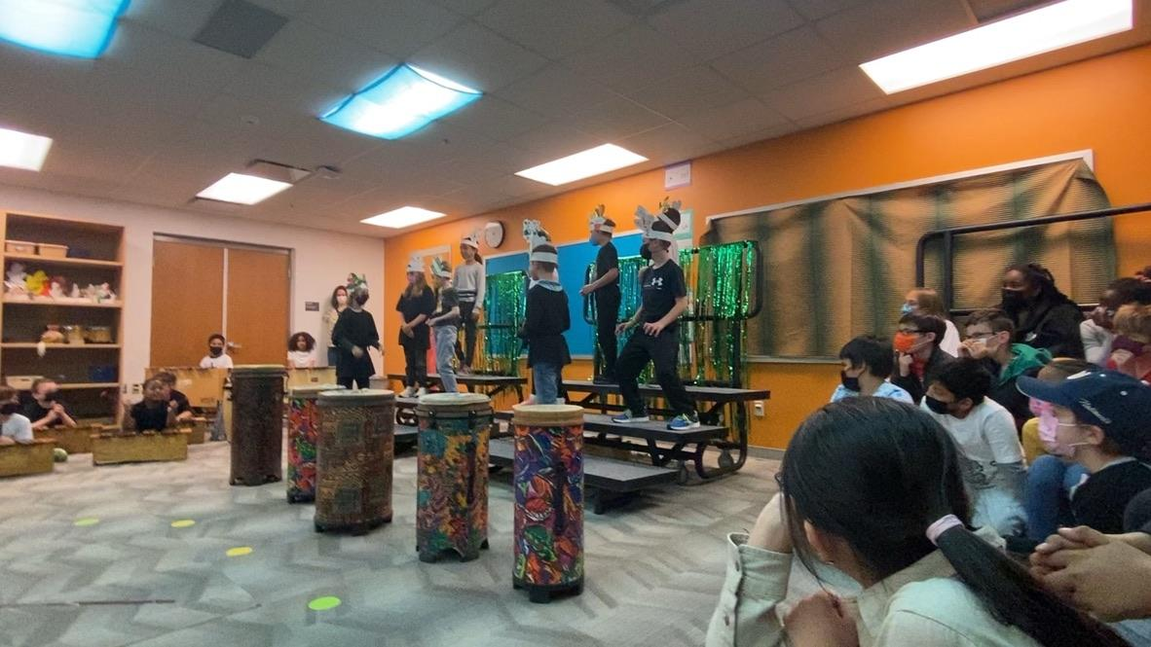
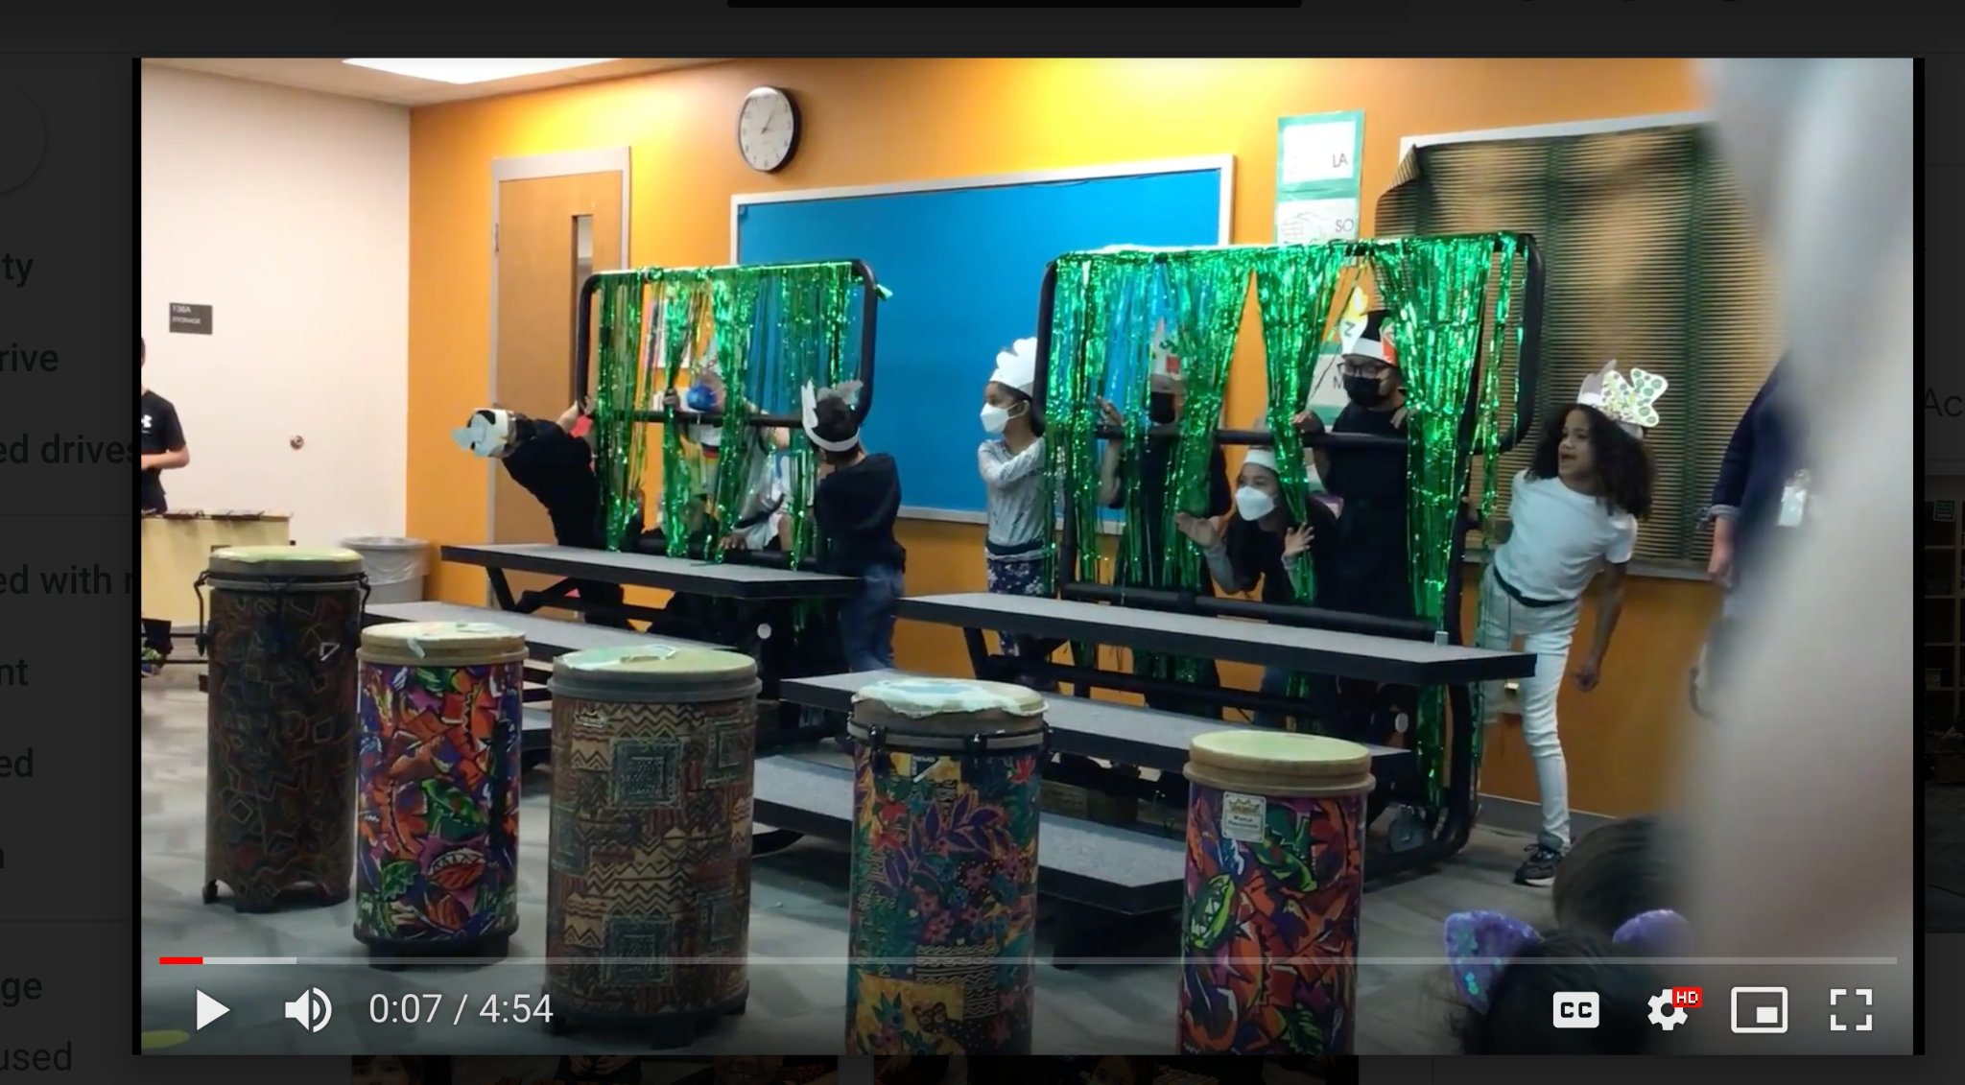
Ghanaian Performance Project:
“The Kudus”

Slide 19
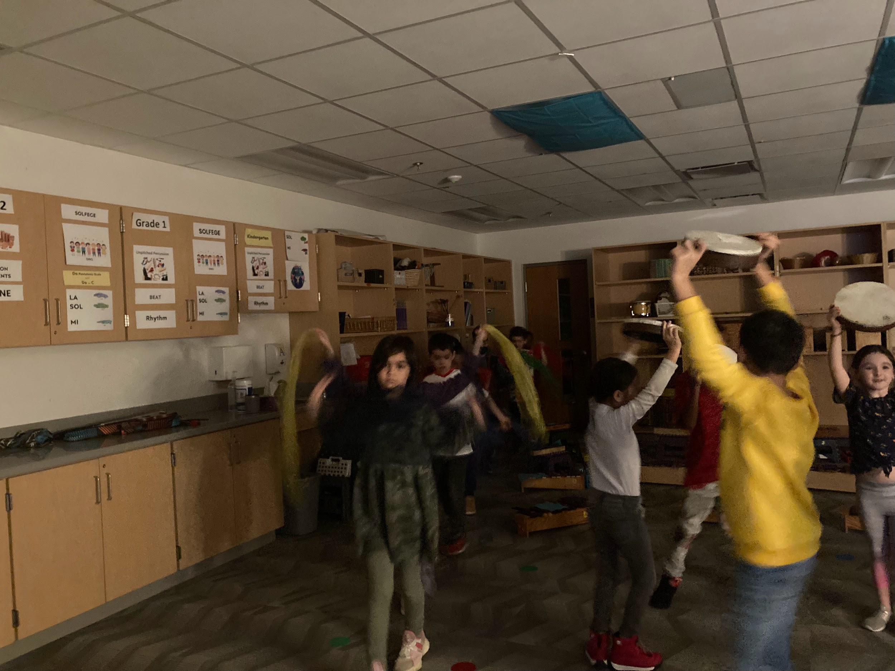
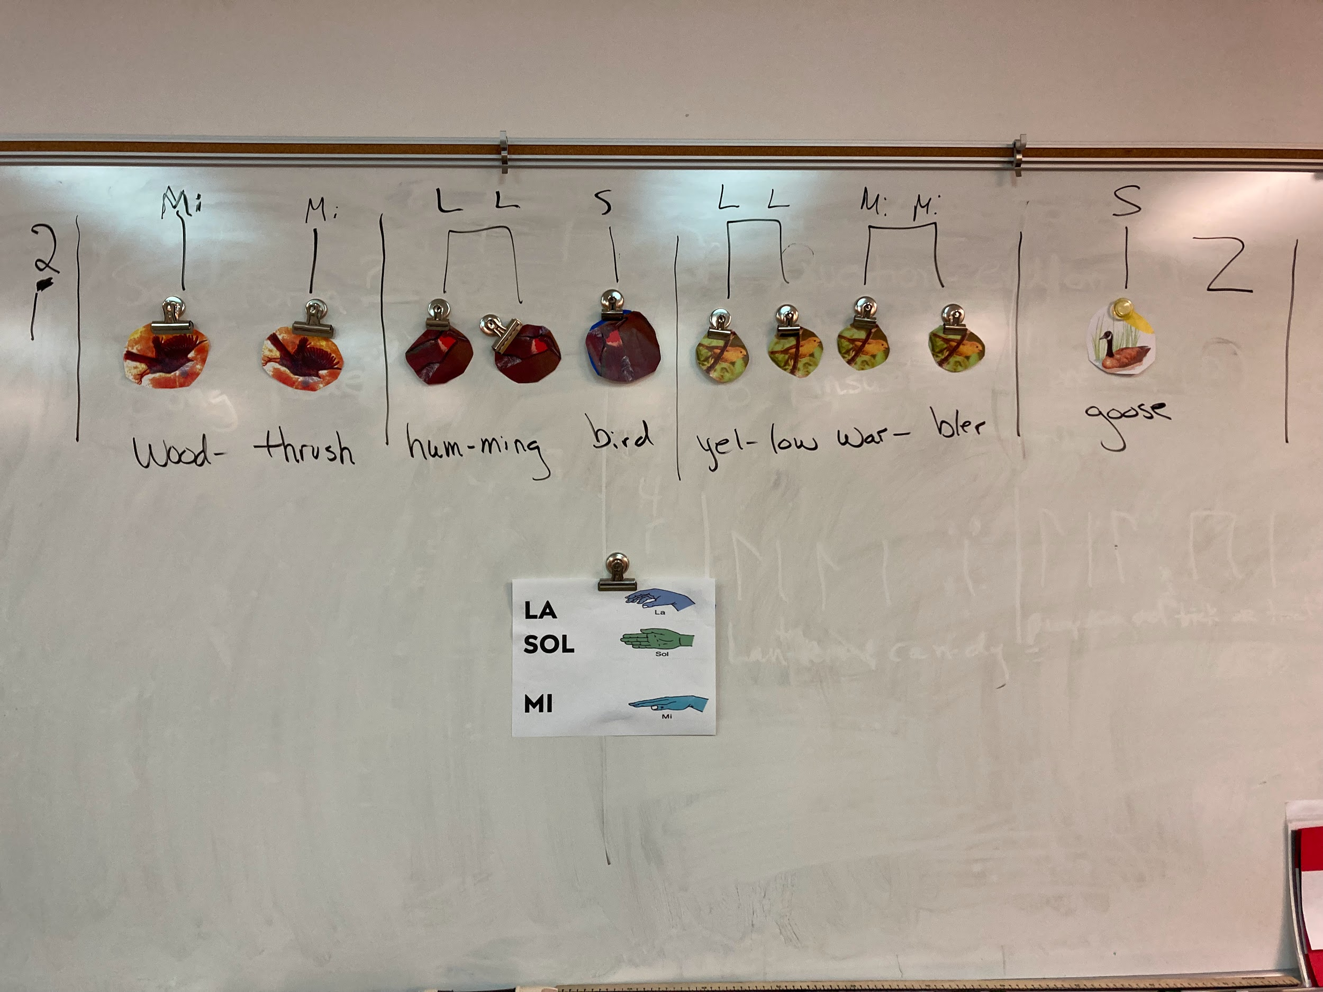
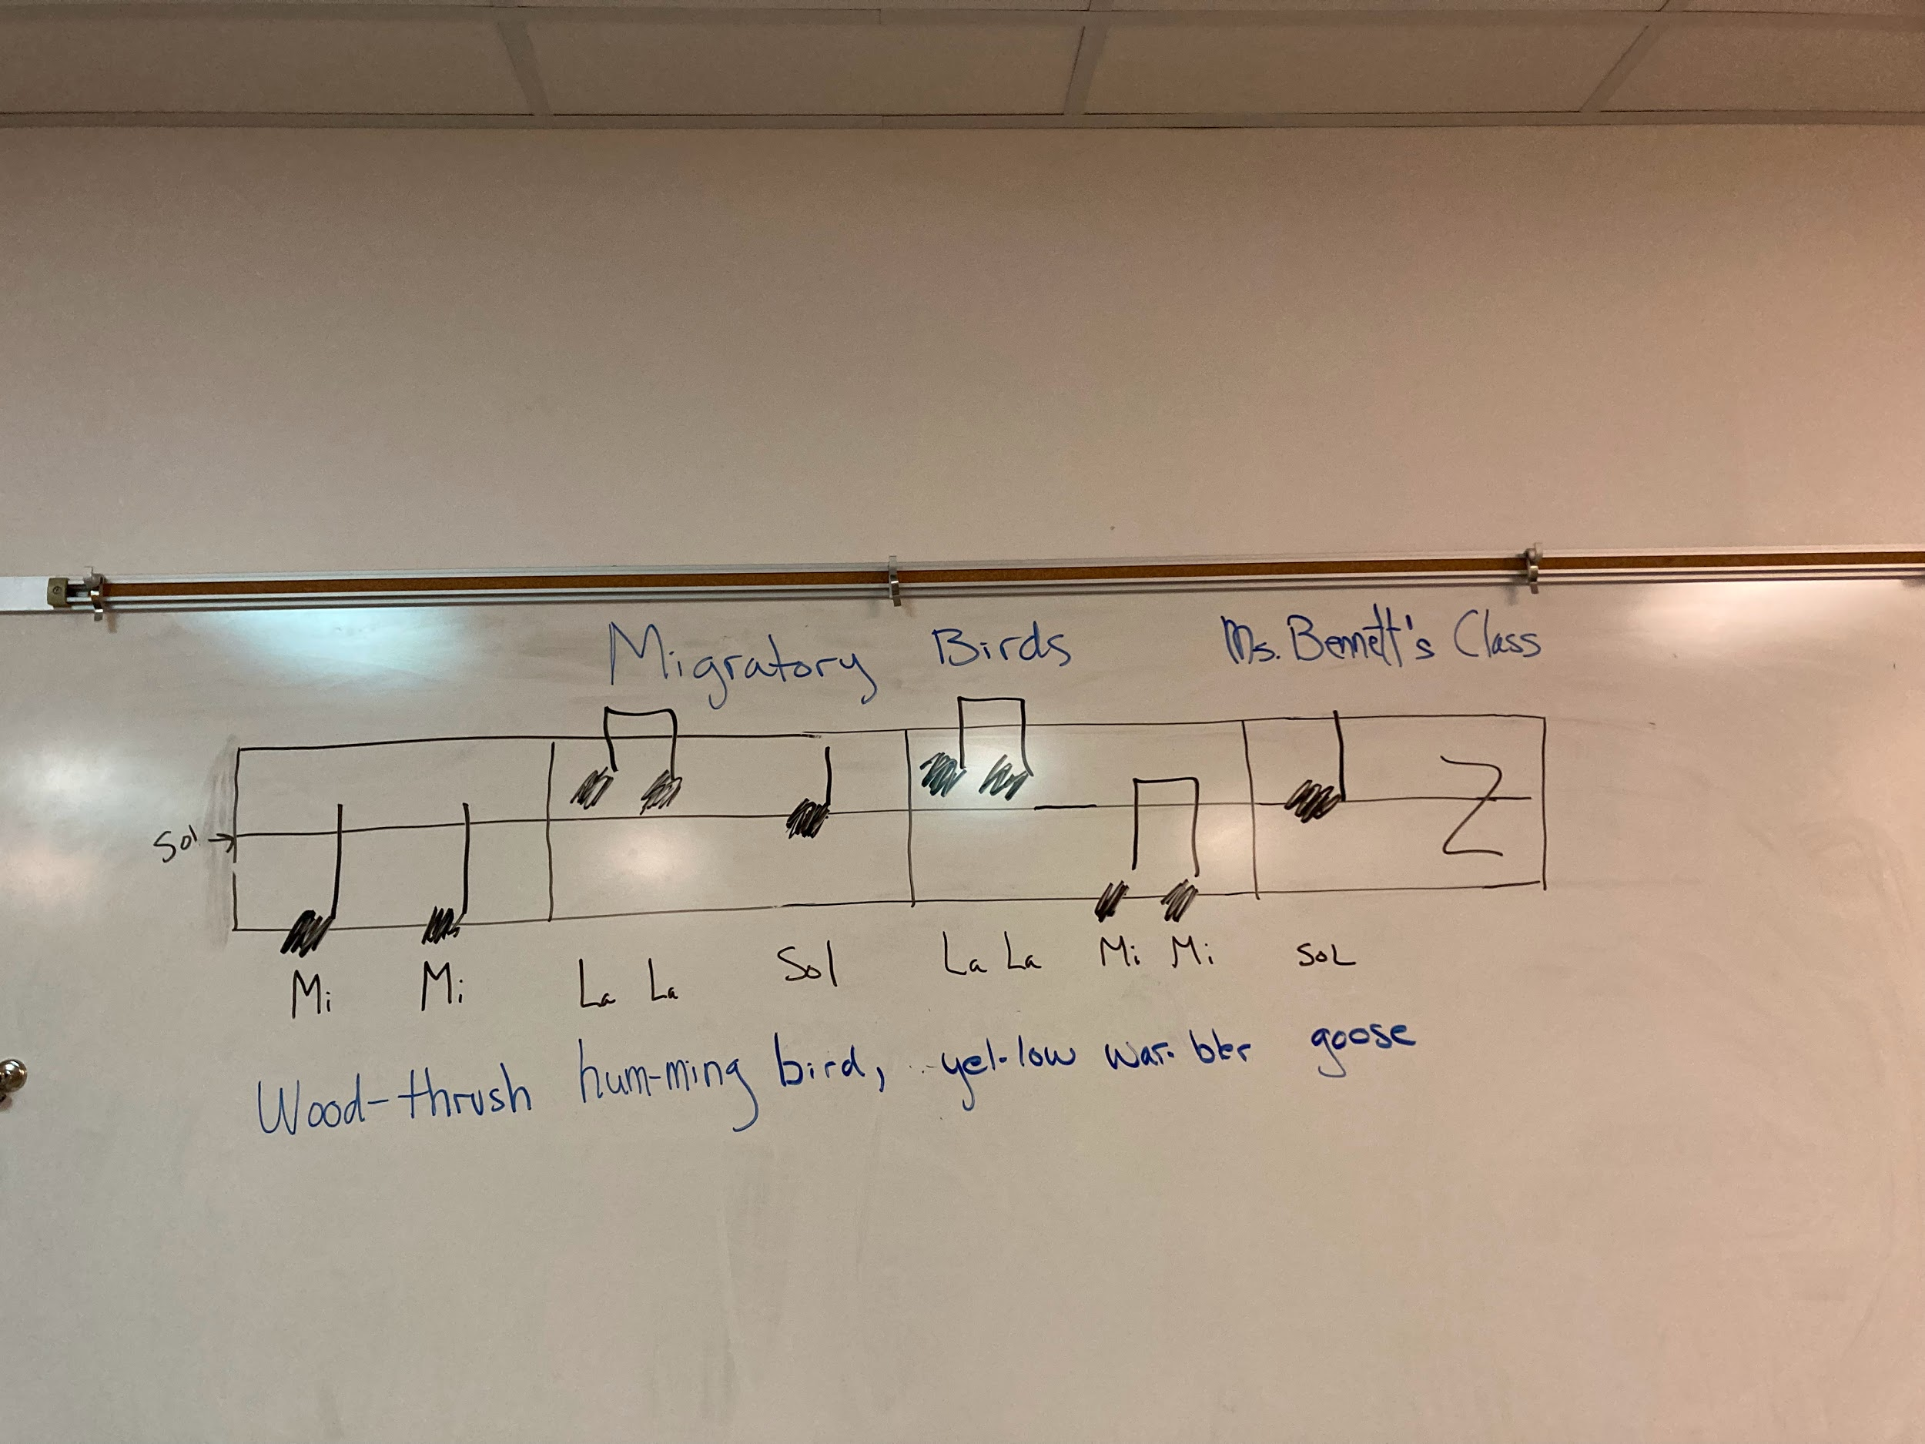
Integrating Performing Arts for pilot program, “Bridging the Americas” with Smithsonian Zoo.

Slide 20
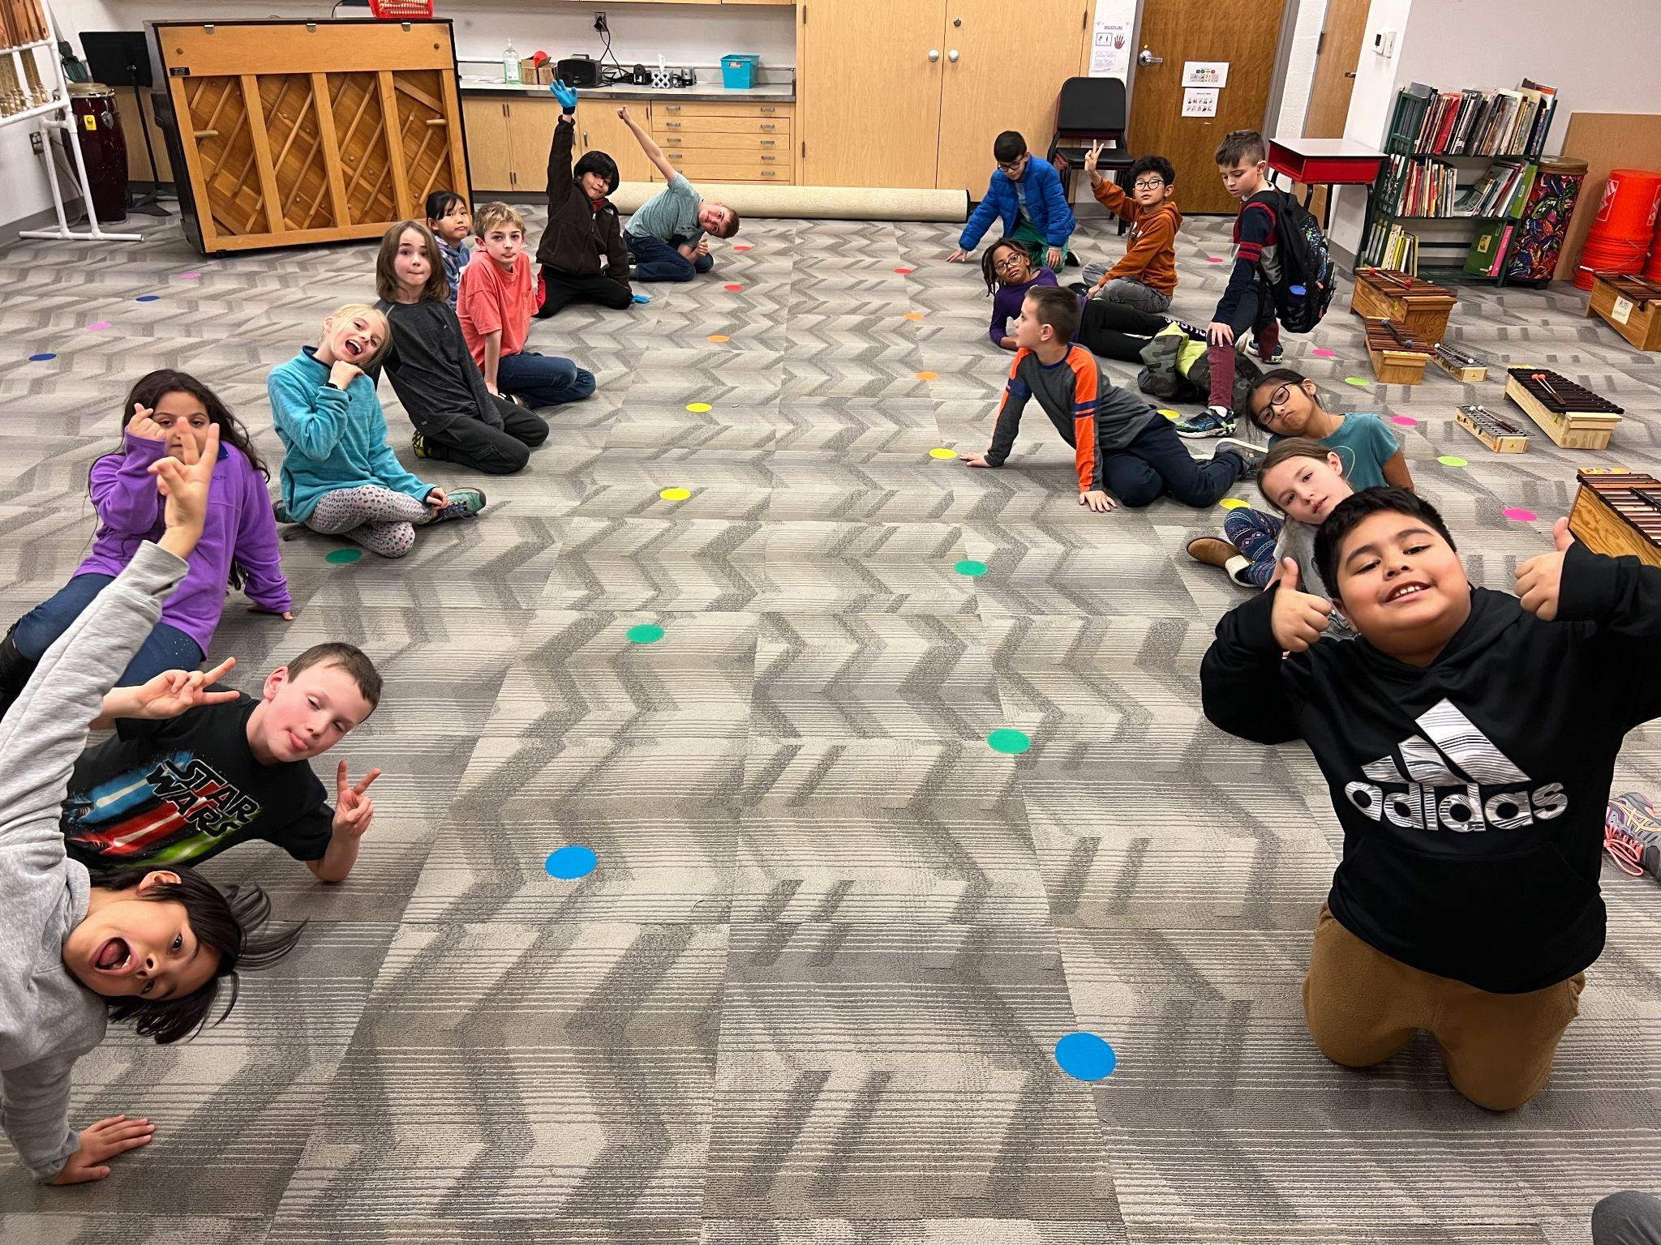
3rd Grade
Review of rhythmic and pitch concepts, adding in:
Rhythmic Elements: syncopation, meter vocabulary with use in notation; values: dotted half note, sixteenth notes, and their rests
expanding on 6/8 time/triple beat division (adding in gallop rhythm)
Extending pentatonic scale pattern up to high do’ and down to la, and so, below do (‘plagal’ notes)
Up to now, all solfege/pentatonic scale work has been in C major–now looking at transposition to other keys (specifically F major), with a new ‘do’ homebase
Some exposure to minor mode (‘la’ as homebase note) and hexatone (adding ‘fa’ into the scale)
Continued use of instruments to play more complex melodies and accompaniments, sometimes 2-3 parts simultaneously
Introduction to full 5-line staff:
pitch identification both by letter and solfege names
understanding/reading melodic contour on the staff (same note, moving by step, or skip/leap)
Increasingly complex dances and movement activities, often accompanied with instruments and singing

Slide 21
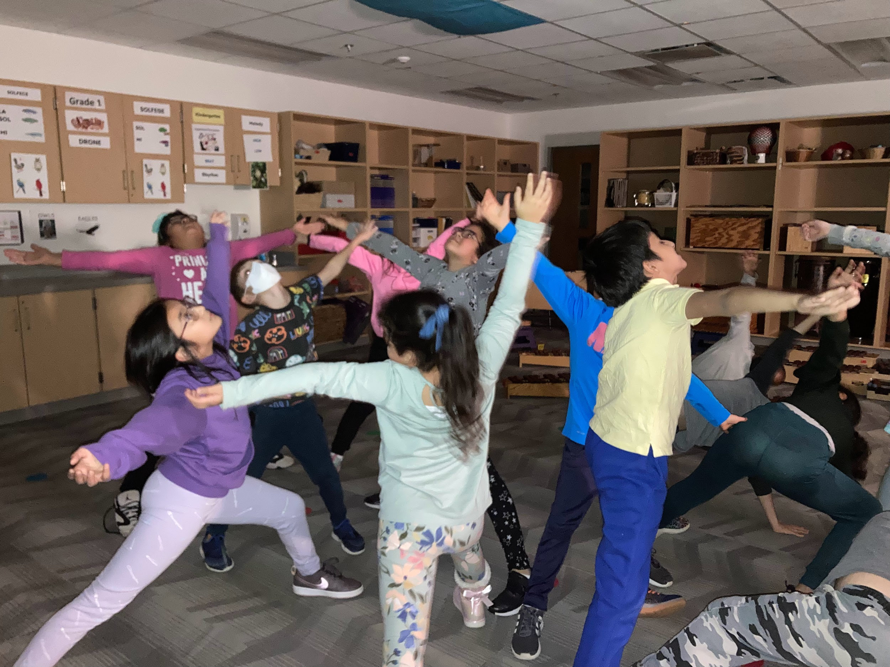
Collaborative Star Constellation with UP Focus.

Slide 22
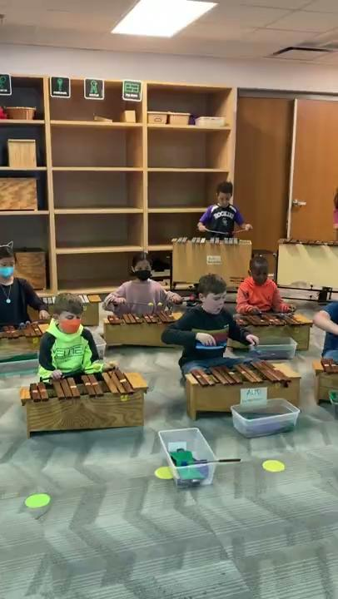
Mi, Re, Do rain song: playing melody in both octaves; enlarging form with interlude

Slide 23
4th Grade
Integration with Virginia Social Studies through music, dances, dramatizations of stories/events.
Increasingly complex rhythms practiced through a variety of mediums: songs, movement, body-percussion, instrumental work
Dotted quarter notes (in duple time)
Sixteenth/eighth note combinations
Mixed meter
Do and La pentatonic scales are increased in use, (major and minor forms); the remaining pentatonic modes are also are explored for their “affect” and application to multi-cultures.
Singing complexity increases to use of rounds, partner songs and continued use of ostinatos and counter-melodies to provide texture and harmony. Attention to elements of singing technique: posture, breath, diction, imagery.
Whole class, individual, and small group composition projects in music and dance based on poetry, proverbs and subjects of student interest.
Continued awareness and purposeful use of the elements of music through music-making, movement activities and critical listening (pitch, rhythm, dynamics, tempo, articulation, timbre, form, texture)

Slide 24

Introduction to “Arise”

Slide 25
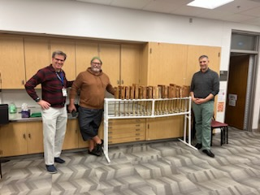
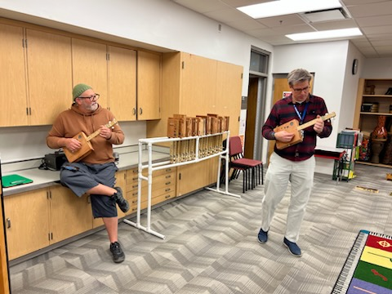
5th Grade
Increasingly complex rhythms explored
Dotted quarter notes (in duple time)
Sixteenth/eighth note combinations
Syncopation (placing stress/accents off the main beat)
While pentatonic scale is still used regularly (major and minor forms), the full diatonic major/minor scales are explored as well as other modes
Singing complexity increases to 2-3 parts at times (typically rounds or melodies with ostinato parts), as well as instrumental pieces and song accompaniments (2-4 parts)
Increasingly complex dances (longways set, circle and mixer dances) and thematically oriented creative movement.
Story dramatization including music and movement with dialogue.
Introduction to concepts of functional harmony (I-V-I and I-IV-V-I) taught through rounds, 12-bar blues, and world music examples
Use of ukulele as both an accompaniment/harmony instrument and a melodic instrument to reinforce functional harmony, scales and note reading
Some world music drumming ensembles, from 2-5 parts, used to accompany songs
Whole class, individual, and small group composition projects
Exploration of elements of music (pitch, rhythm, dynamics, tempo, articulation, timbre, form, texture) through critical listening and other activities/games
Science of Sound SOL unit reinforced through musical context

Slide 26
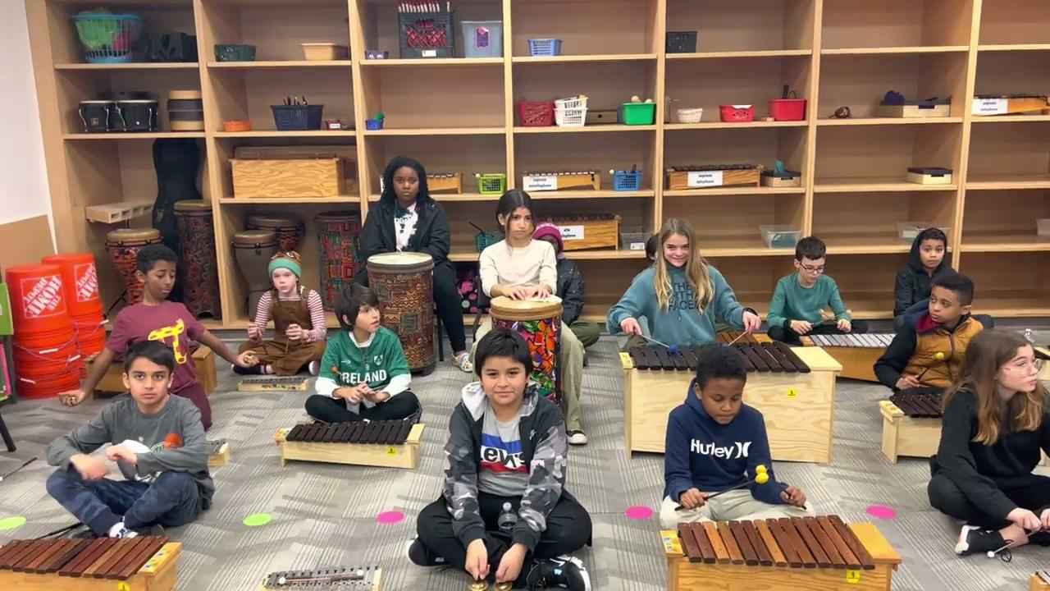
SHCHEDRYK (Ukrainian New Year’s Carol)

Slide 27






Instrumental Music
Band and Orchestra

Slide 28
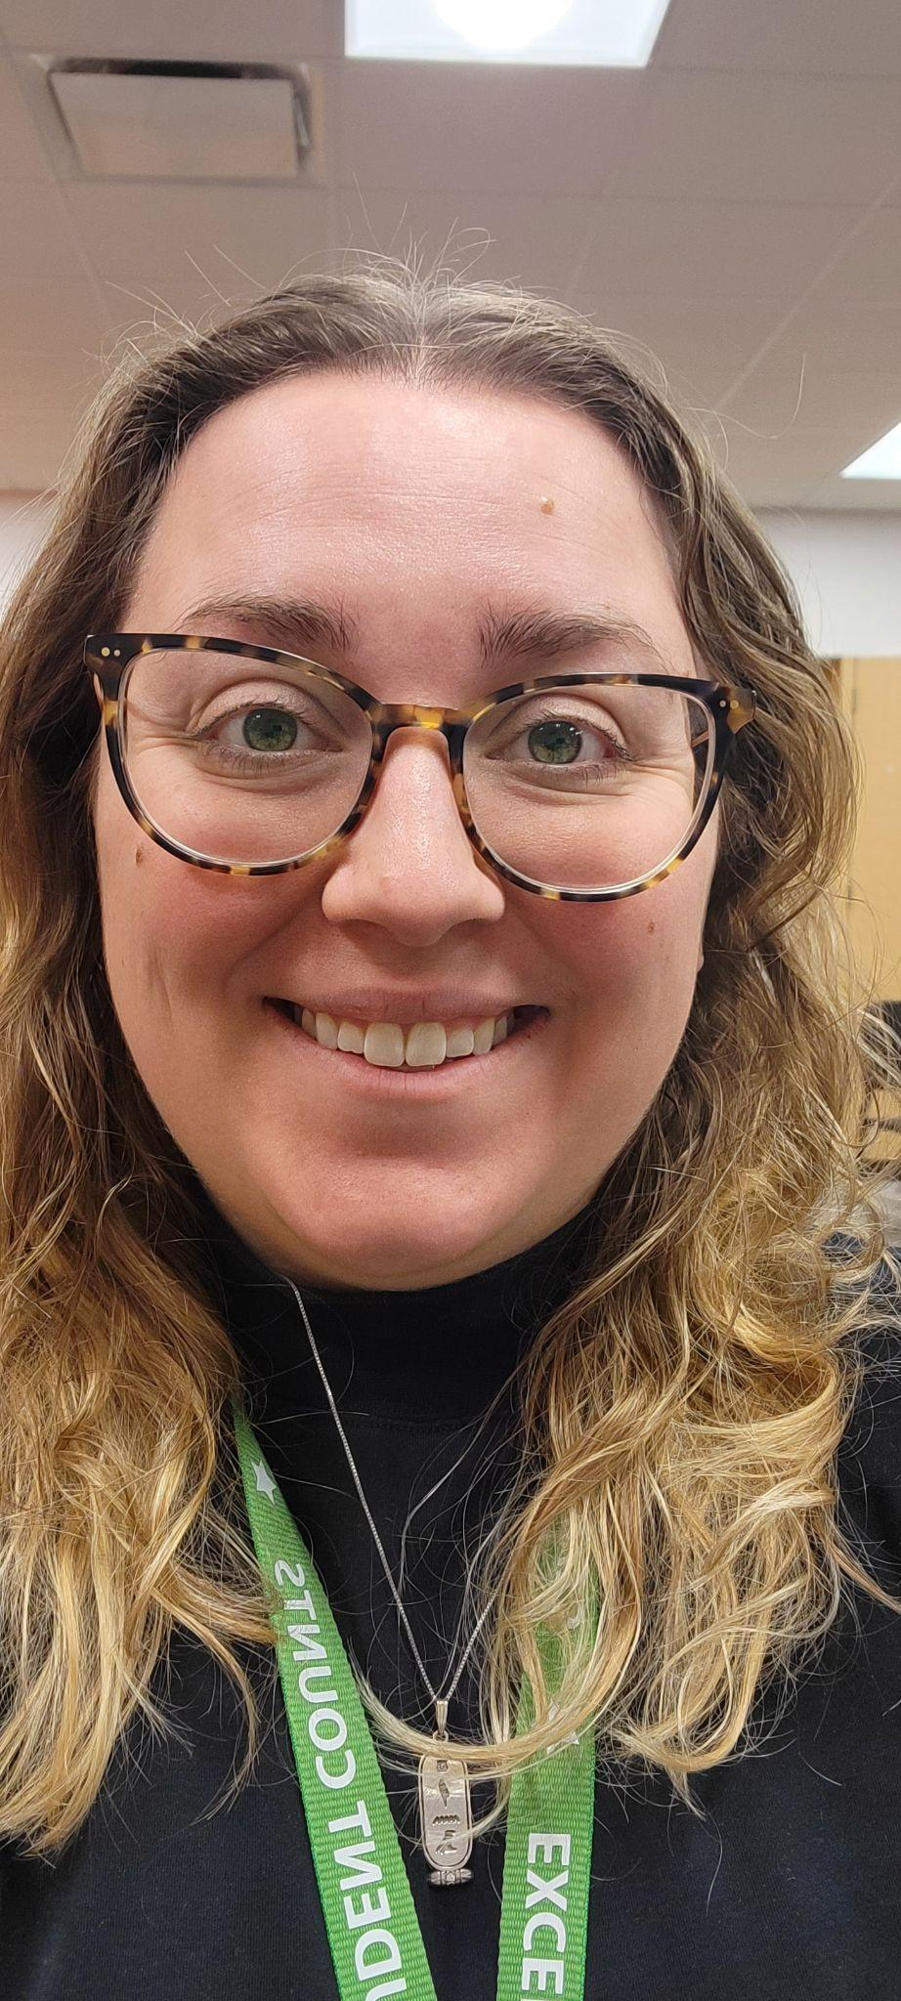
Mrs. Koesterer
-Undergraduate degree from University of Missouri in Music Education
-Master’s degree in Music Education with an emphasis in Curriculum from the University of Michigan (obtained last Summer)
-Primary instrument is flute
-I’ve been in APS the last 3 years, teaching general music and orchestra and this past year made the switch to teaching all Band and Orchestra.

Slide 29
Overview
Both 4th and 5th grade band and orchestra build upon the knowledge they gain in music since kindergarten. When we add in the complexities of playing an instrument, we pull back from more challenging rhythms and other elements and focus on instrument posture/position, achieving a characteristic tone quality on their instrument and gaining fluency reading music on the music staff.
Band and Orchestra are both performing ensembles and typically give two concerts a year, one in the Winter and one in Spring.

Slide 30
Instruments offered
Band:
Flute
Clarinet
Trumpet
Trombone
Baritone
Percussion
Orchestra:
Violin
Viola
Cello
***Students stay on the same instrument for both 4th and 5th grade***

Slide 31
4th grade ORchestra
Pizzicato technique
Basic bow hold technique
Bowing arco technique
Bowing on one string at a time
Learning the notes of the D major scale
Learning how to read music on the music staff
Playing in Unison

Slide 32
5th Grade Orchestra
Bowing arco technique, slurs and continuing to use pizzicato technique
Learning past the notes of the D major scale
Incorporating more string crossings with the bow
Gaining fluency reading music on the music staff
Playing in multiple parts

Slide 33
4th grade band
Air use
Consistently producing a characteristic tone
Instrument posture/position
Gaining fluency reading music on the staff
Learning the first 5 notes
Playing in unison

Slide 34
5th grade band
Air use
Consistently producing a characteristic tone
Instrument posture/position
Gaining fluency reading music on the staff
Learning past the first 5 notes and adding more challenging rhythms
Playing in multiple parts

